Slide 1


Gravitational Waves: Experimental Techniques
3
Gabriele Vajente
LIGO Laboratory – California Institute of Technology
TRISEP 2018 - Perimeter Institute

Slide 2
Outline
Lecture 1: the basics of interferometric detection of gravitational waves
Lecture 2: fundamental noise sources (seismic, thermal and quantum noises)
Lecture 3: the dirty reality of ”technical noises” (scattered light, control noise, etc…) and prospects for the future

Slide 3
Technical Noise sources, status of the detectors and the future
Lecture 3

Slide 4
Technical noise sources

Slide 5
Advanced LIGO design

Slide 6
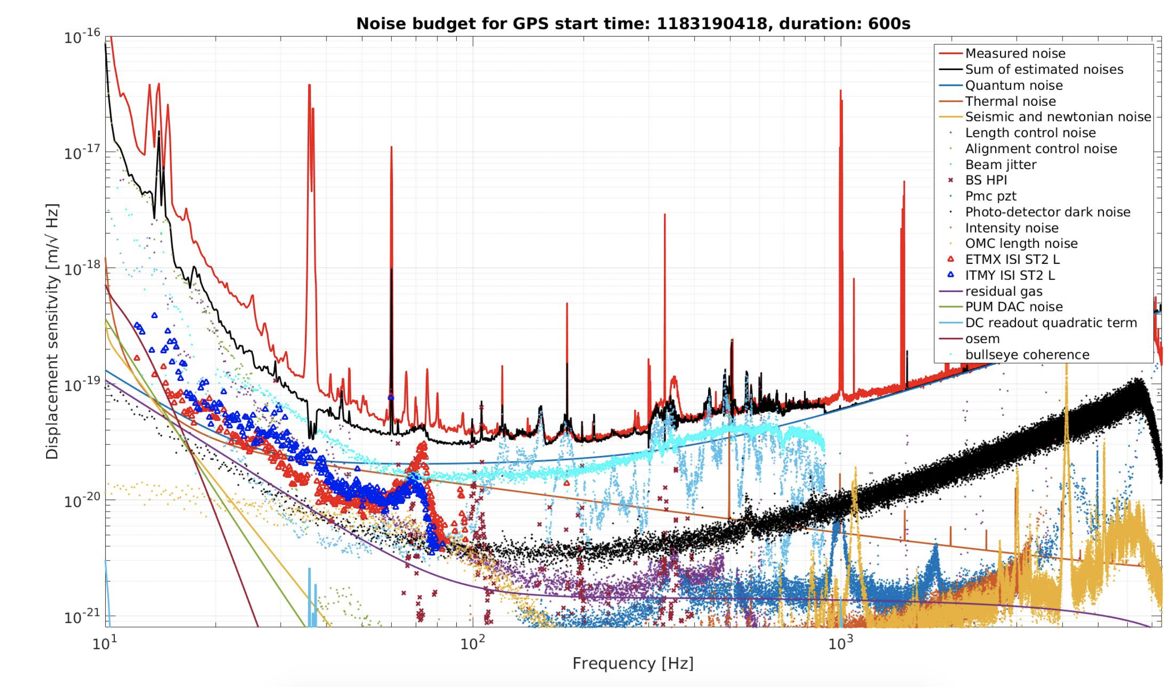

Slide 7
Technical noises
Feedback control noise: longitudinal and angular
Laser noises: frequency, intensity, jitter
Electronic noises
Scattered light
Environmental noises: acoustic, electromagnetic, seismic

Slide 8
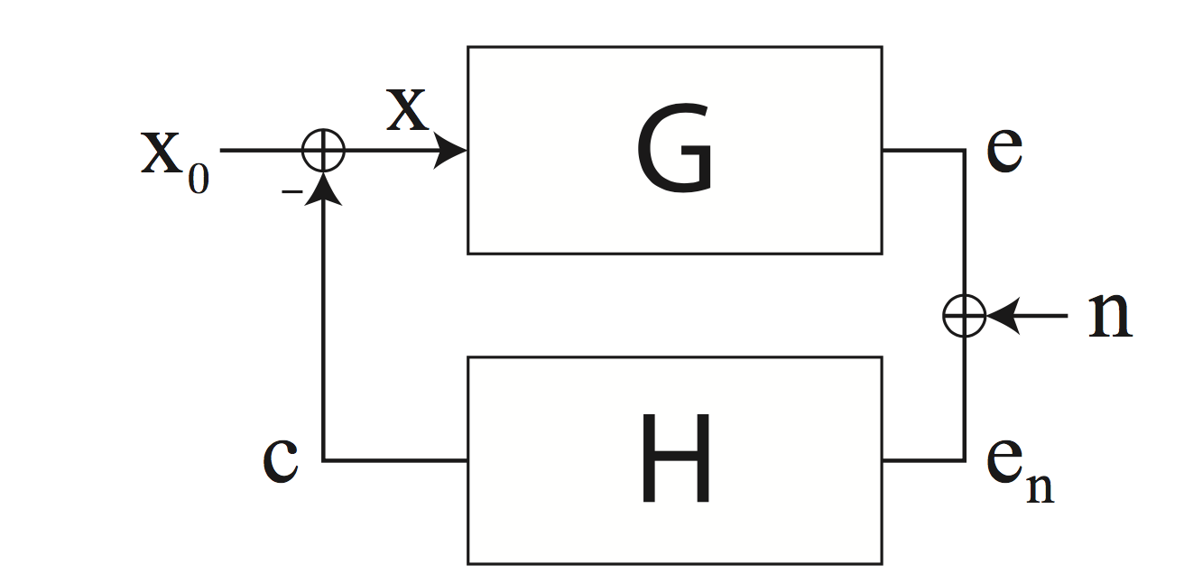
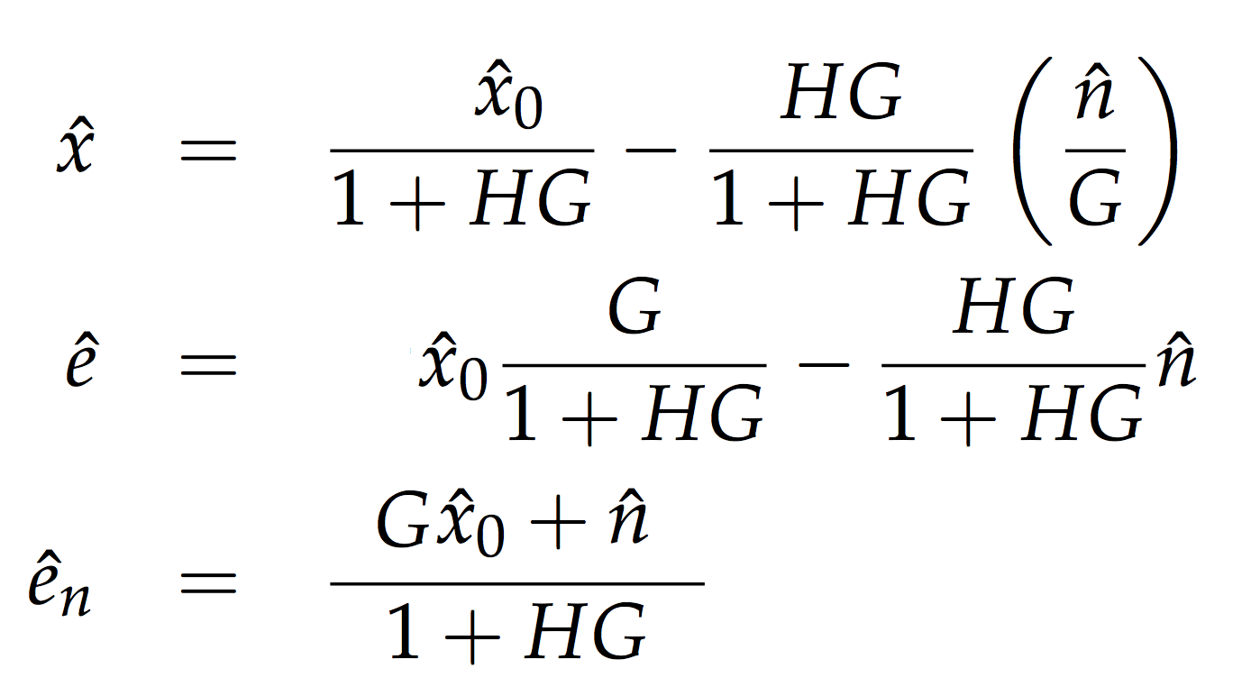
Feedback control noise

Slide 9
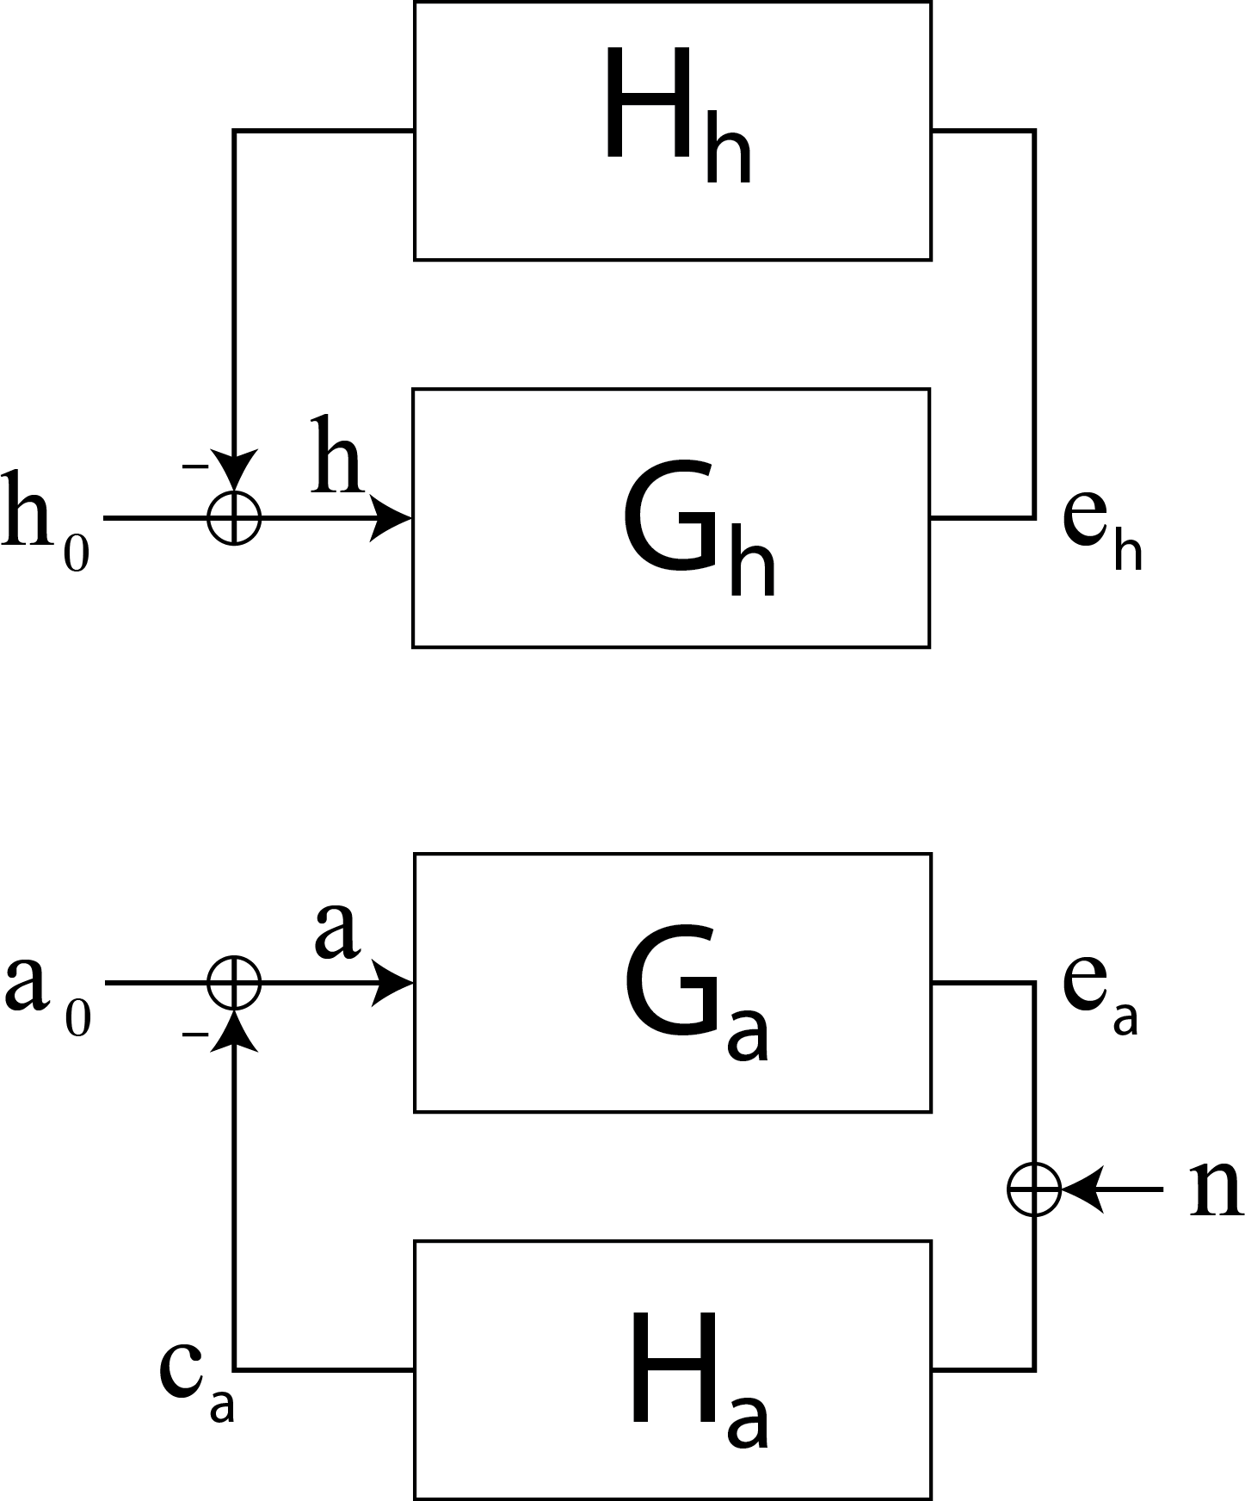
Why does it matter?
Our system is not completely diagonal: auxiliary degrees of freedom couple into the main GW channel

Slide 10
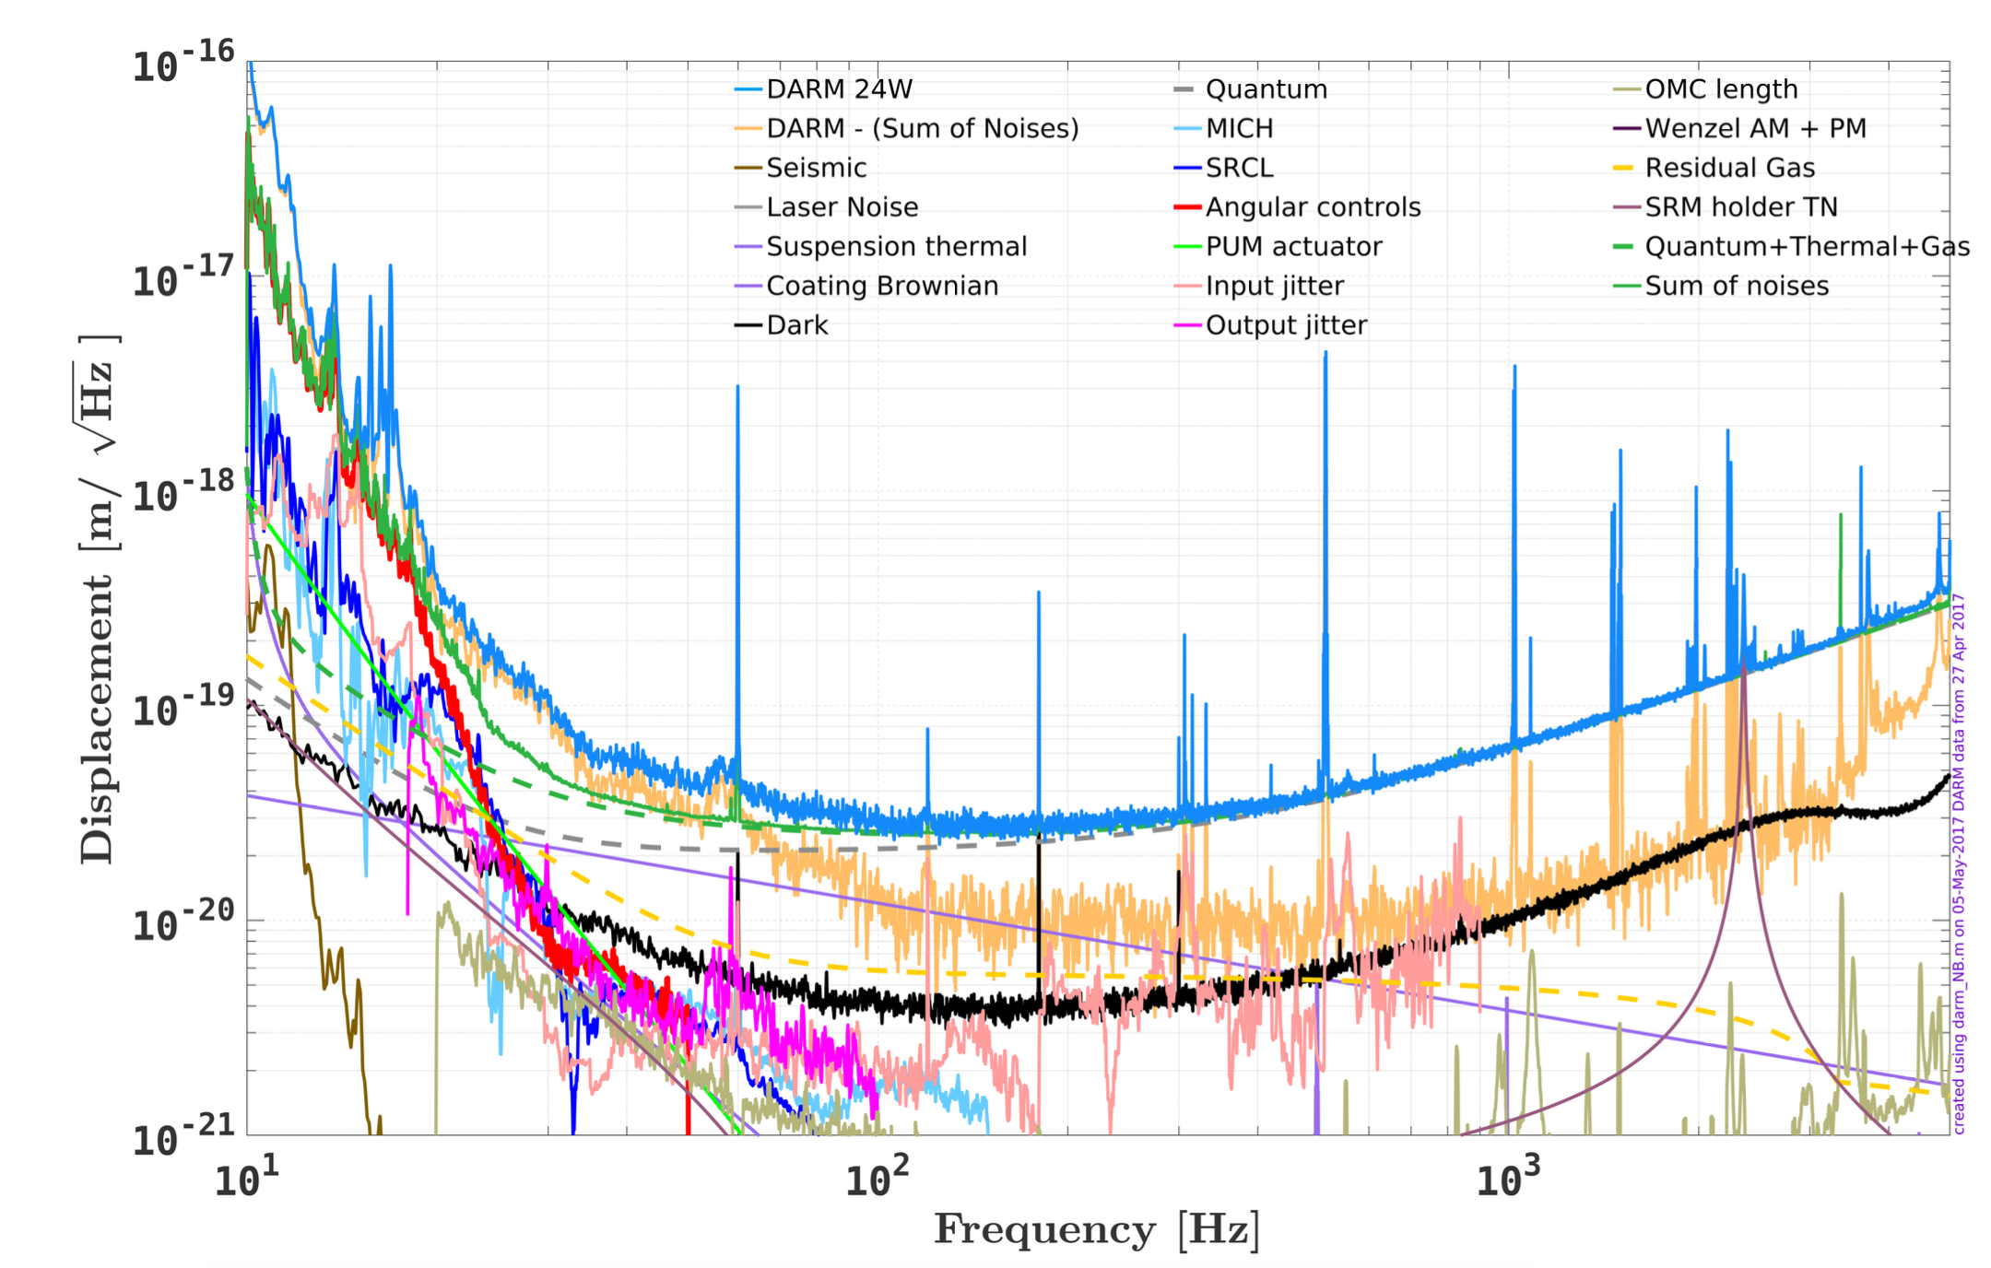

Slide 11
Laser noises: intensity
We measure the GW signal in a Michelson interferometer by measuring power fluctuations at the anti-symmetric port

Slide 12
Laser noises: frequency

Slide 13
Laser noises: frequency

Slide 14
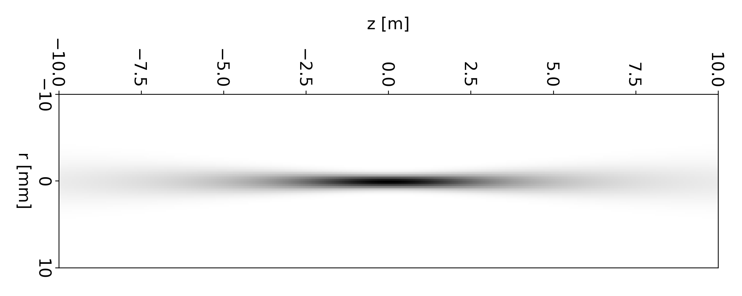
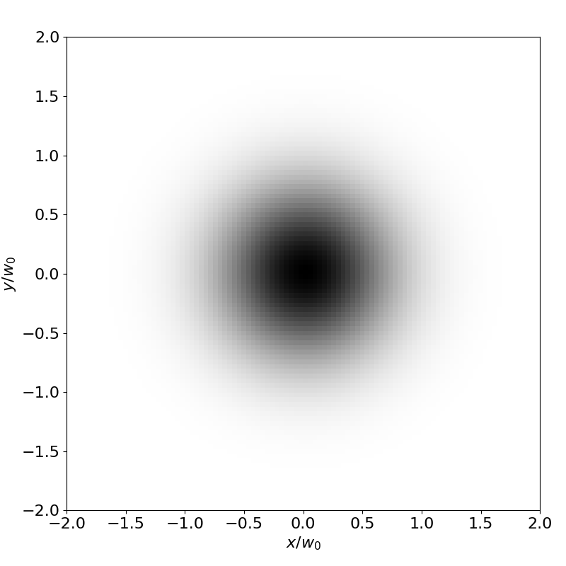
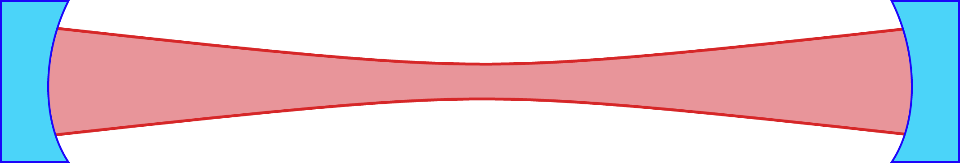
Laser noises: jitter
Change in pointing direction and size of the laser beam

Slide 15
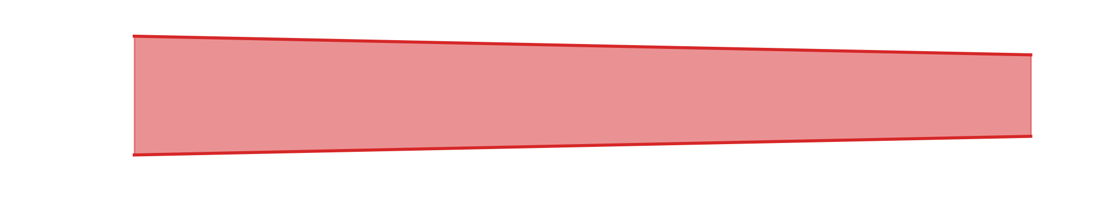

Slide 16
Perfect matching
Tilt
Translation
Wrong curvature
Wrong size

Slide 18
Scattered light

Slide 19
Scattered light
L₂
f₂
L₁
f₃
f₁
Optics Express Vol. 21, pp. 10546-10562 (2013)

Slide 20
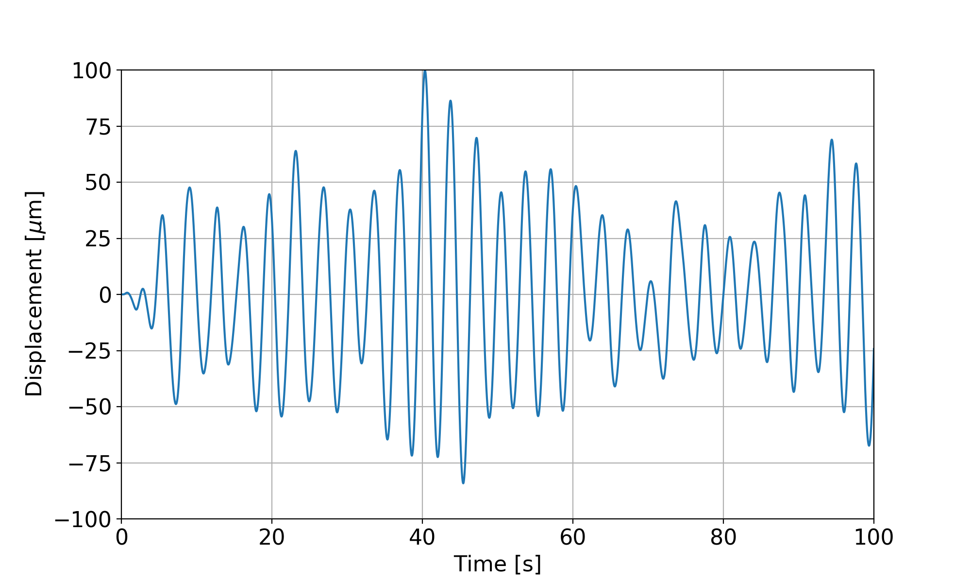
Scattered light

Slide 21
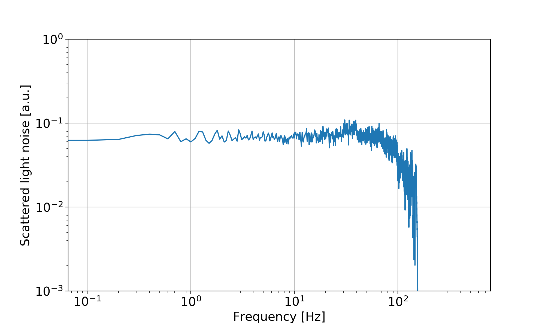
Scattered light

Slide 22
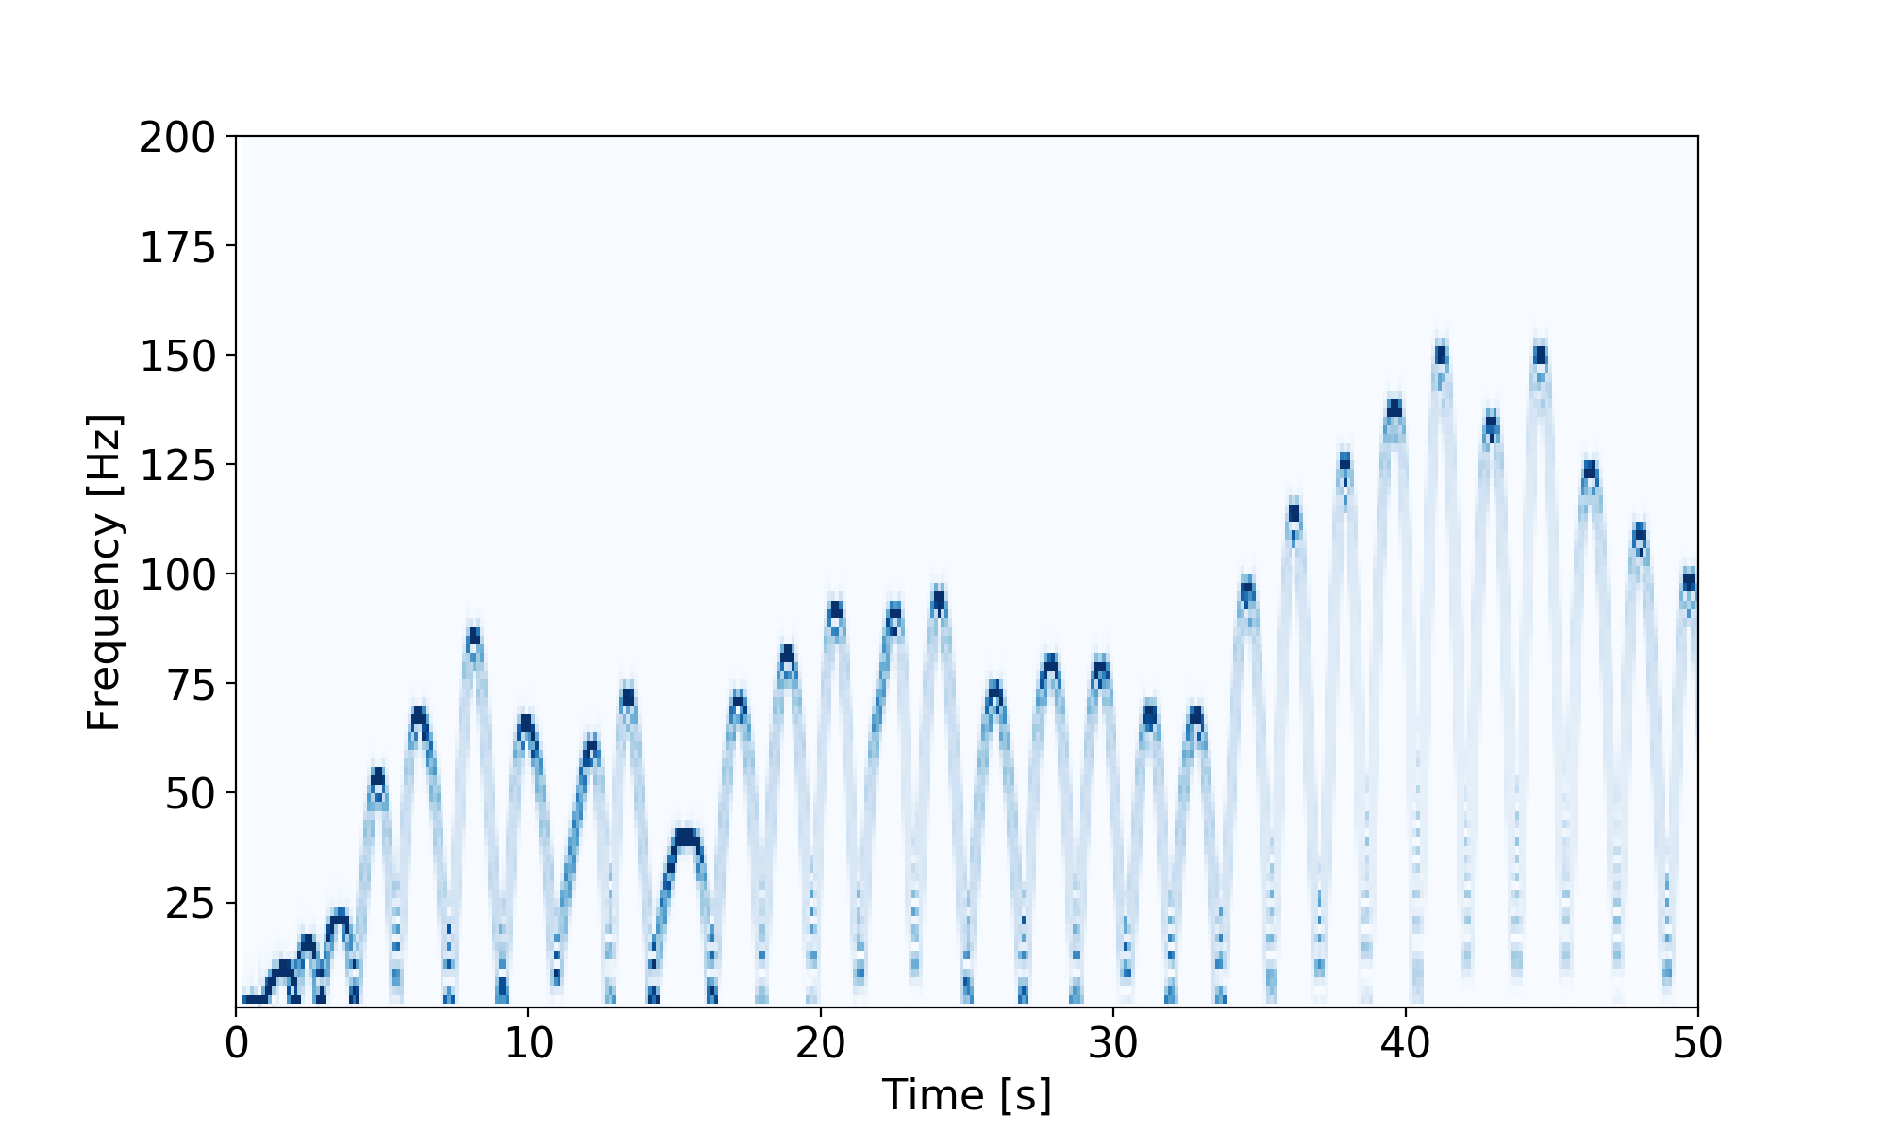
Scattered light

Slide 23
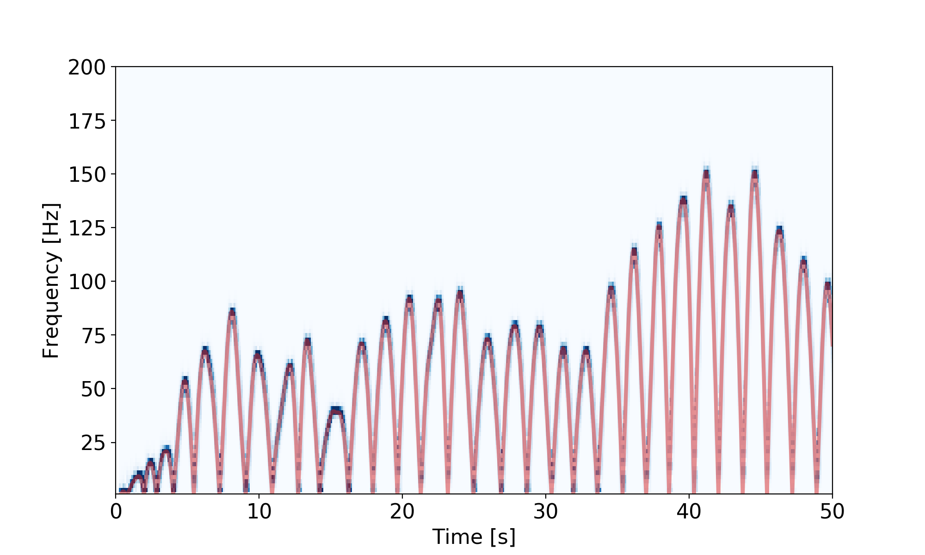
Scattered light

Slide 24
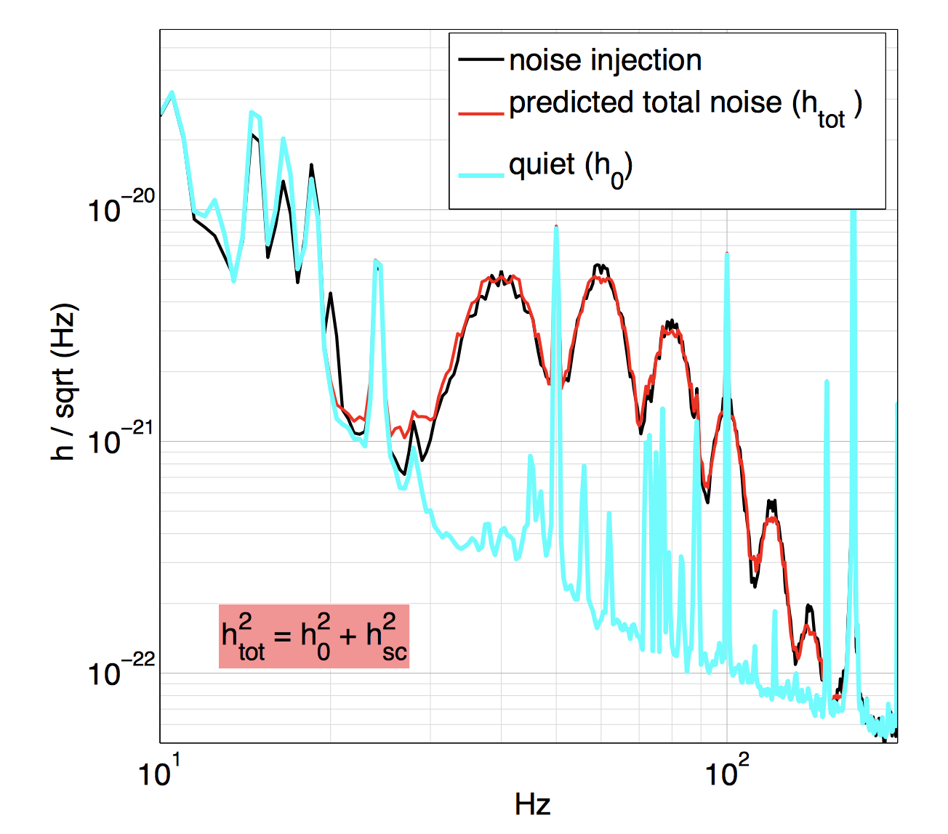
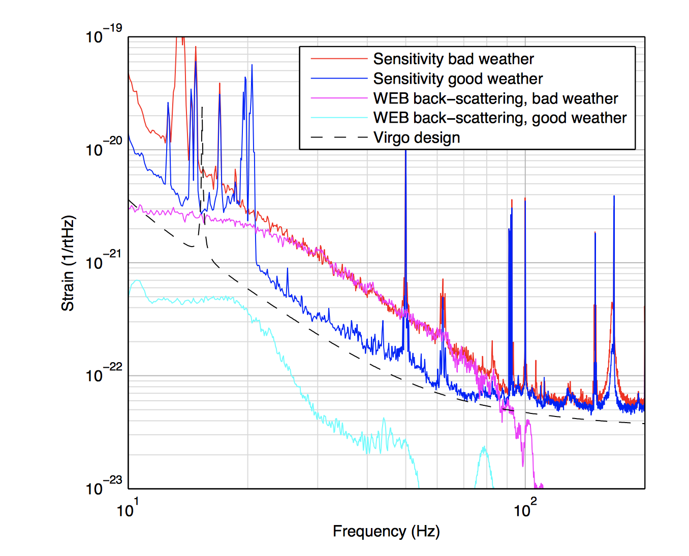
Examples from 1st generation detectors
T Accadia et al 2010 Class. Quantum Grav. 27 194011

Slide 25
Current status

Slide 26
Observation runs: O1 and O2
O1: 2015-2016
O2: 2016-2017

Slide 27
Going into O3
Many improvements:
  New test mass mirrors: to reduce scattering of light and simplify control
  Annular reaction masses: to reduce gas damping
  New laser: lower shot noise with more power
  Frequency independent squeezing: lower shot noise without more power
  Baffles to catch and damp spurious beams, to reduce scattered light noise
Fine tuning of control system and noise studies will follow
Stay tuned for next year’s observing run O3

Slide 28
near term

Slide 29
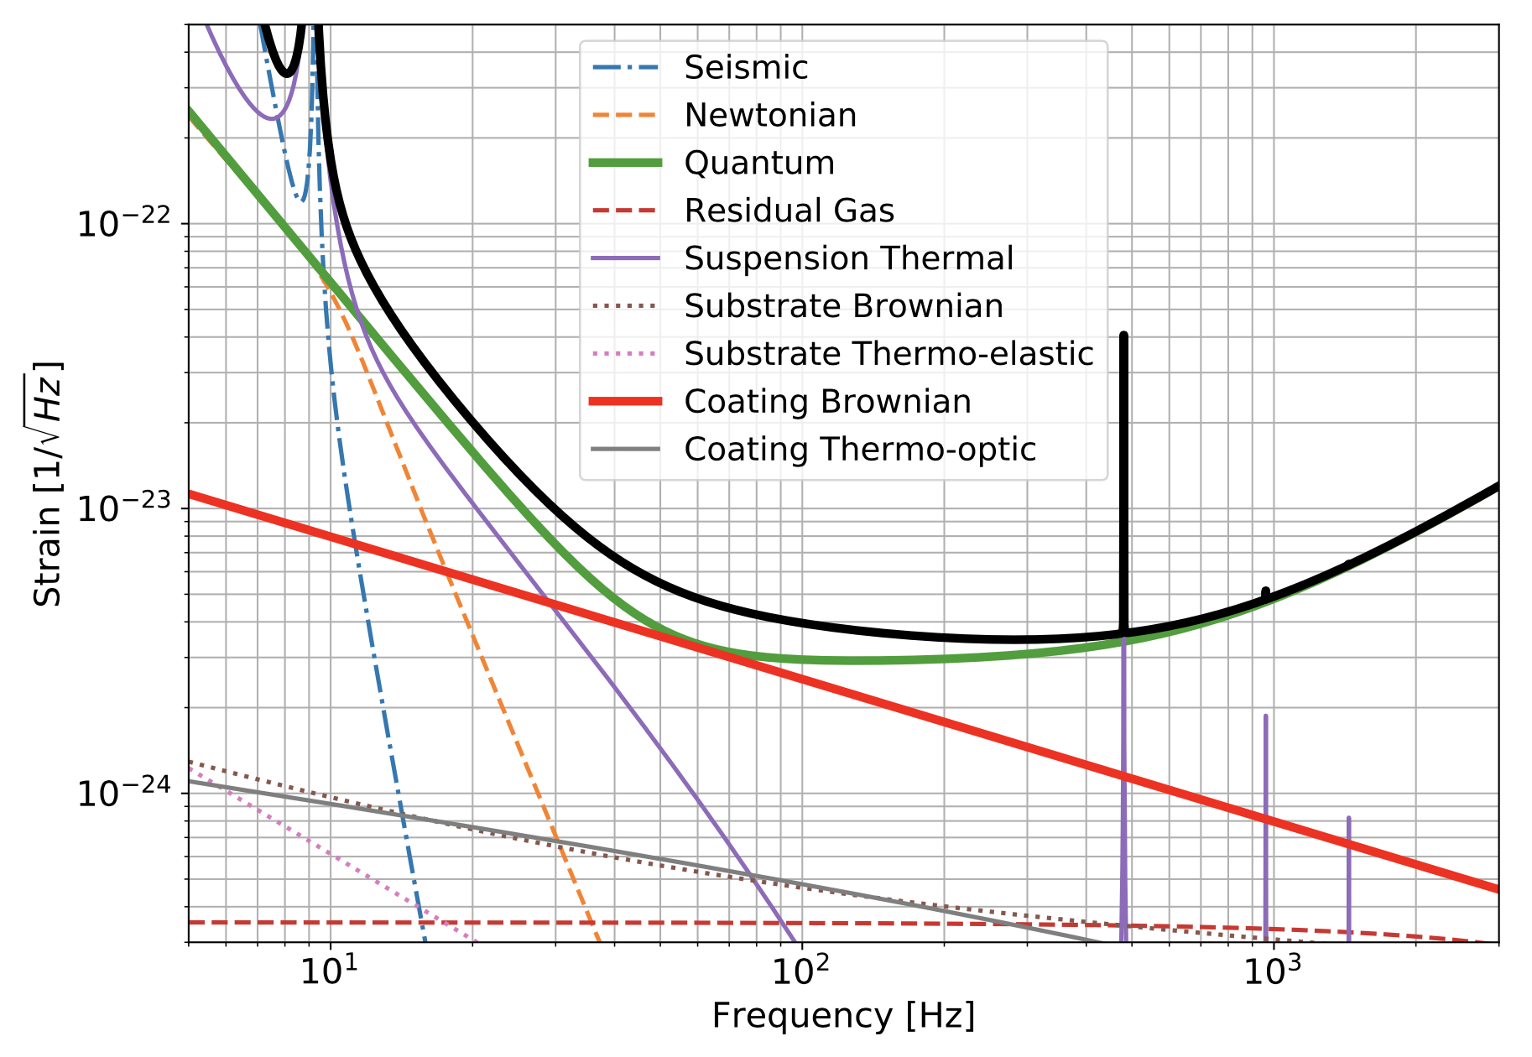
The near future: Advanced LIGO+

Slide 30
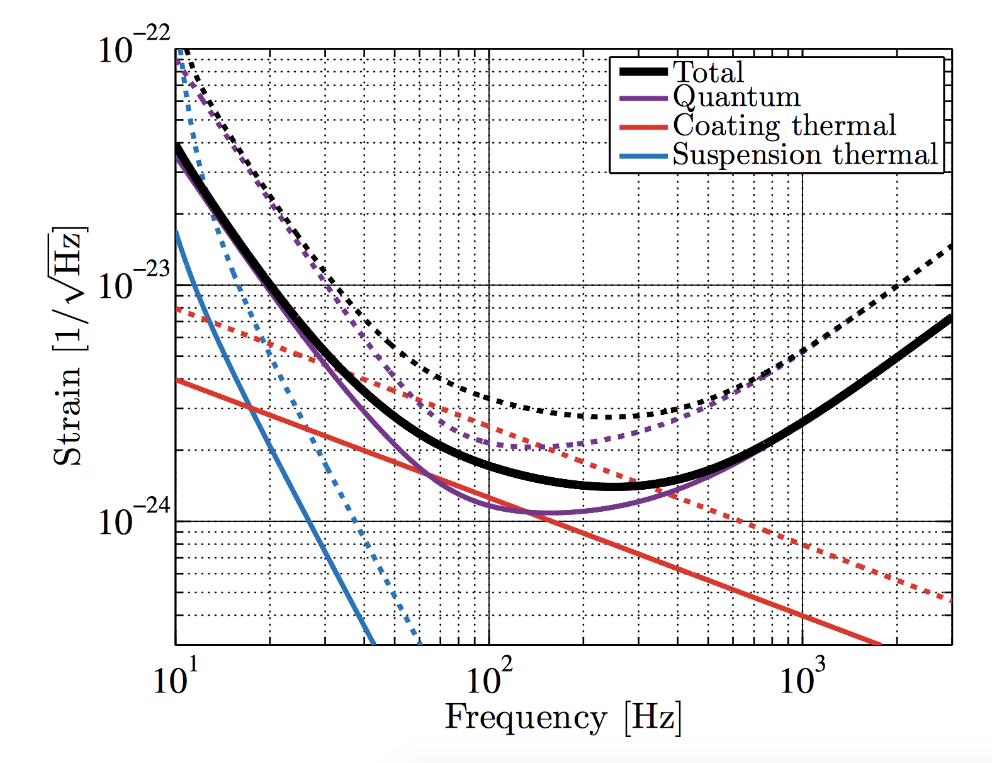
Phys. Rev. D 91, 062005

Slide 31
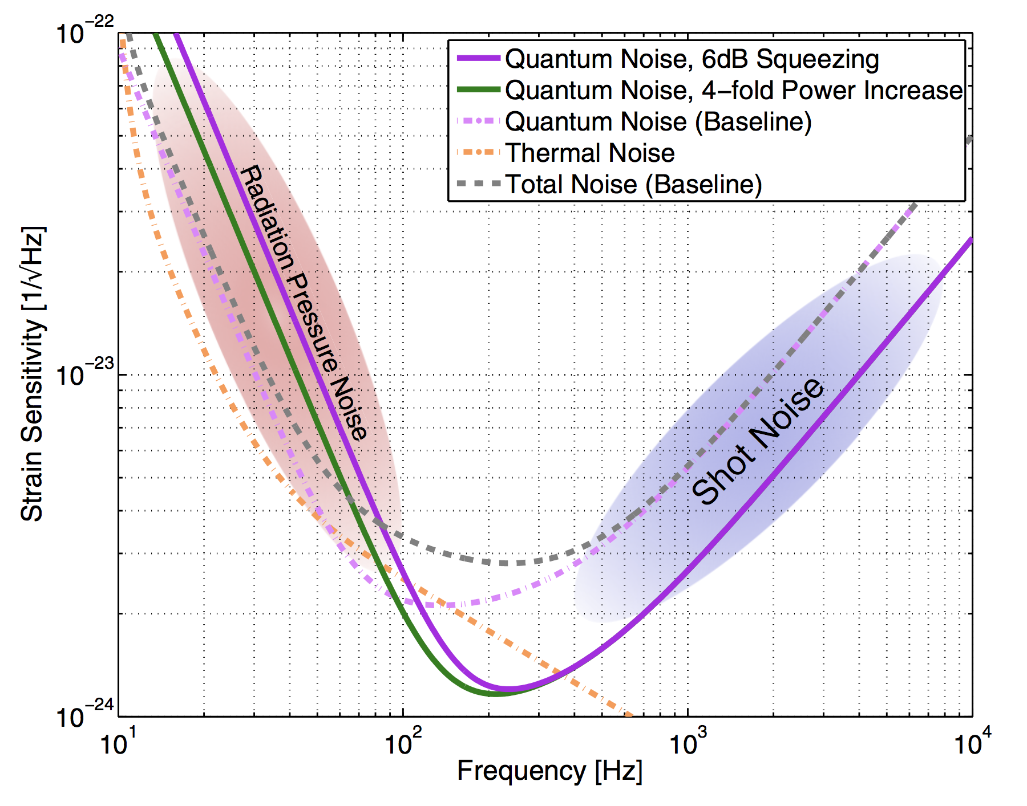
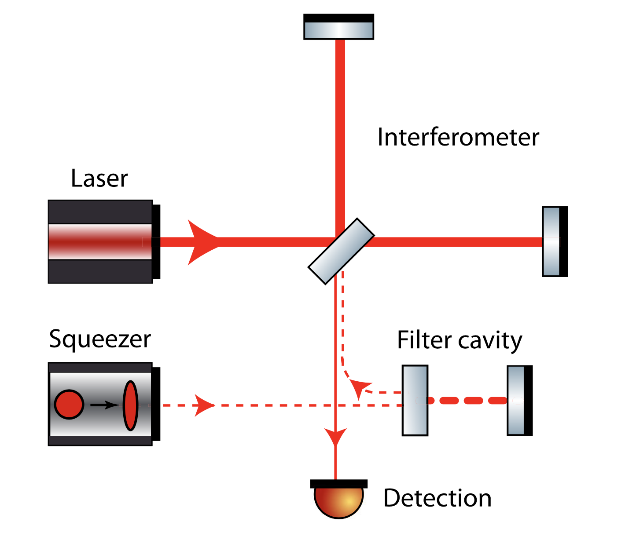
Frequency dependent squeezing
PHYSICAL REVIEW D 88, 022002 (2013)

Slide 32
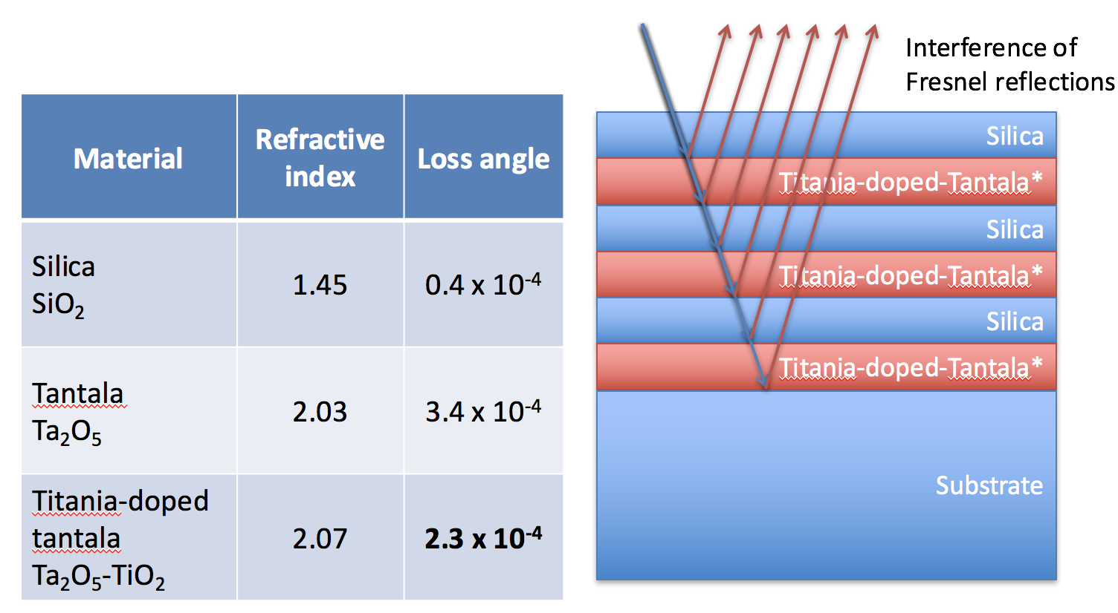
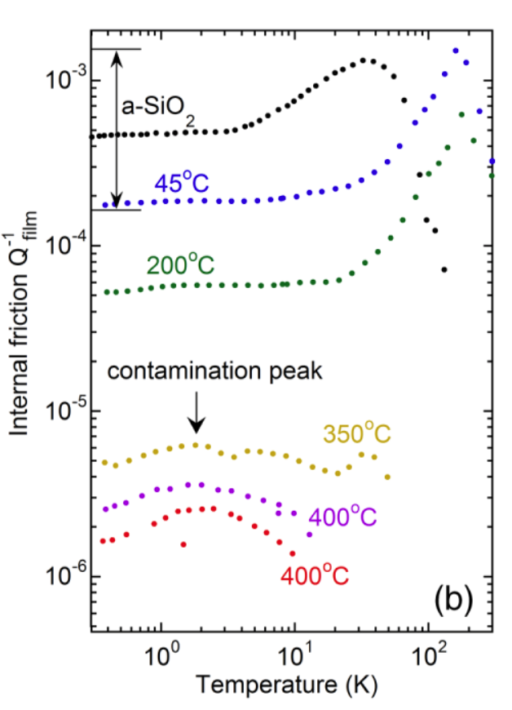
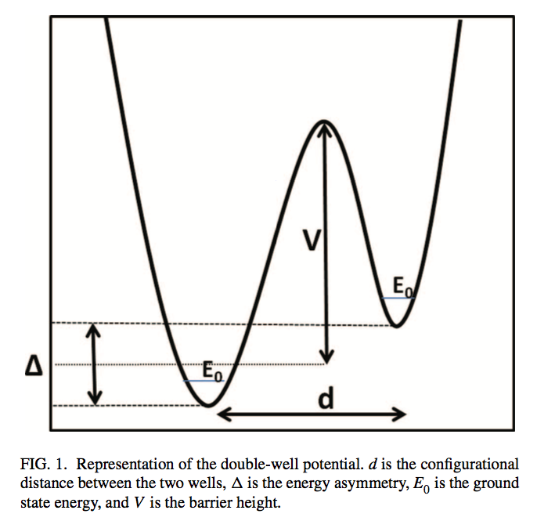
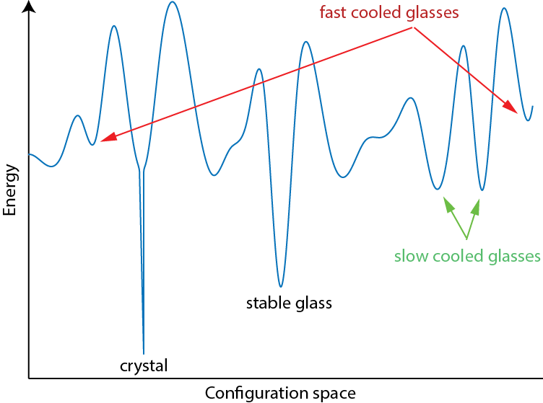
Lower thermal noise
Origin of dissipation:
Tunneling Two Level
Systems
Hamdan et al. J. Chem. Phys. 141, 054501 (2014)
Parisi et al. Nature Materials 12, 94 (2013)

Slide 33
Long term upgrades

Slide 34
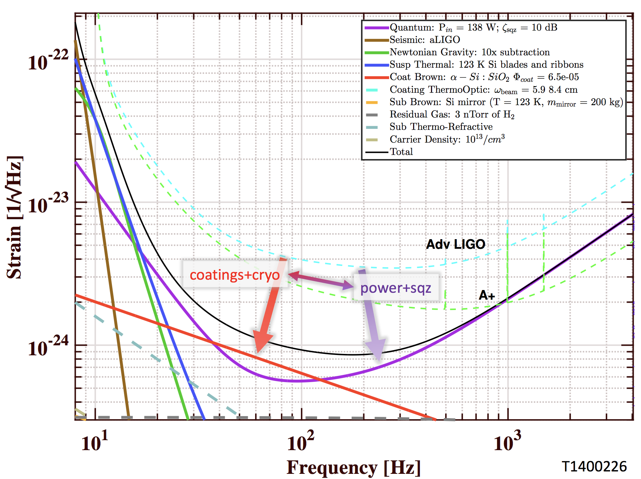
Pushing the facilities to the limit: Voyager
https://dcc.ligo.org/LIGO-G1700848/public

Slide 35
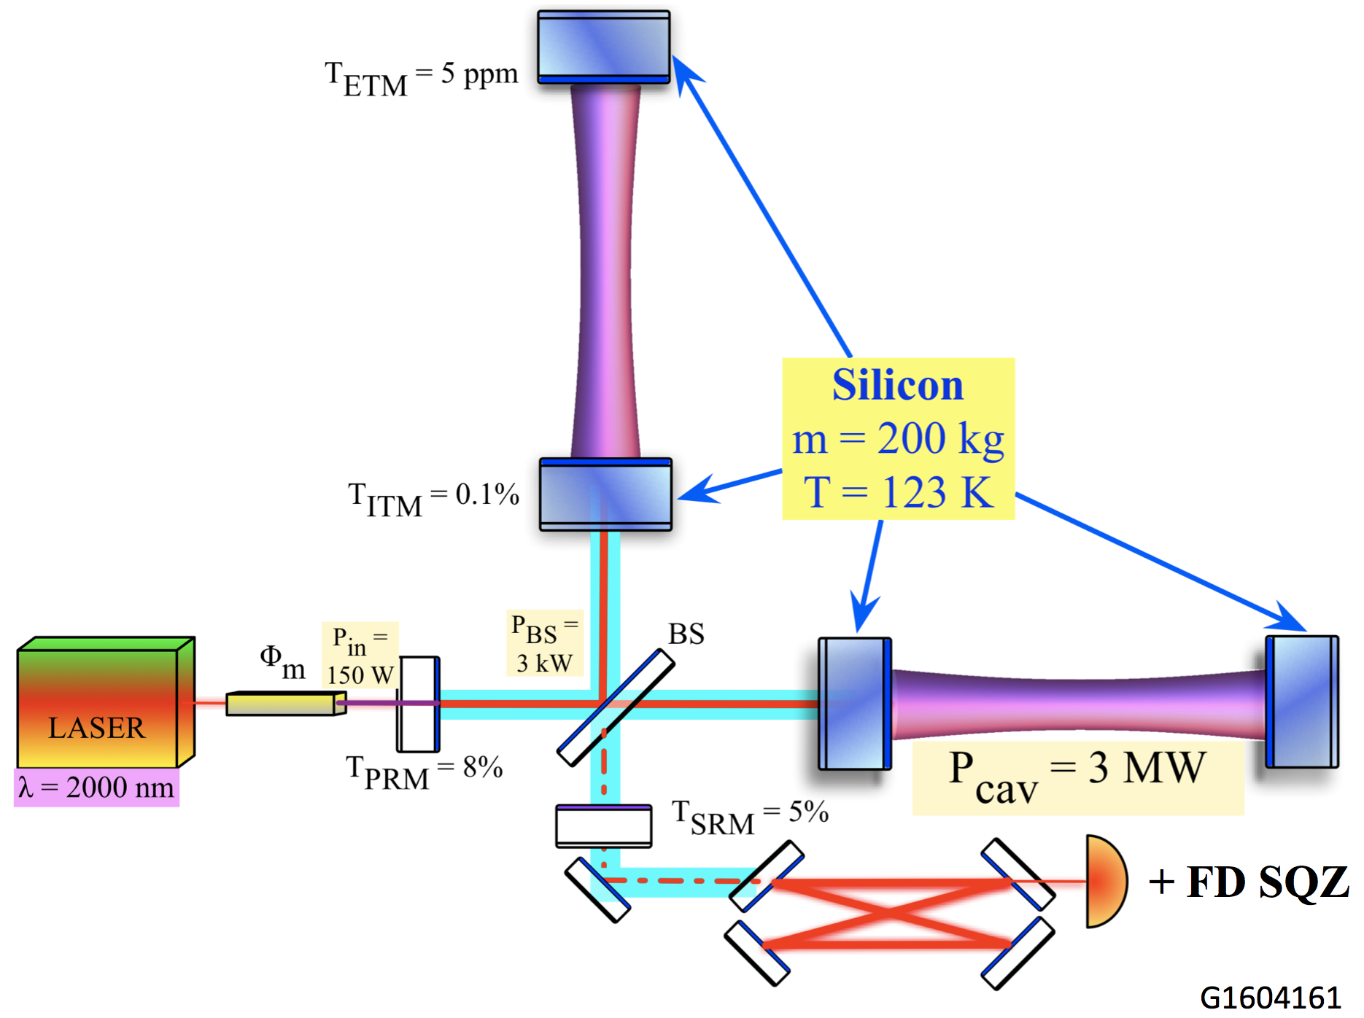
Pushing the facilities to the limit: Voyager
https://dcc.ligo.org/LIGO-G1700848/public

Slide 36
New facilities: Cosmic Explorer
https://dcc.ligo.org/LIGO-G1800983/public

Slide 37
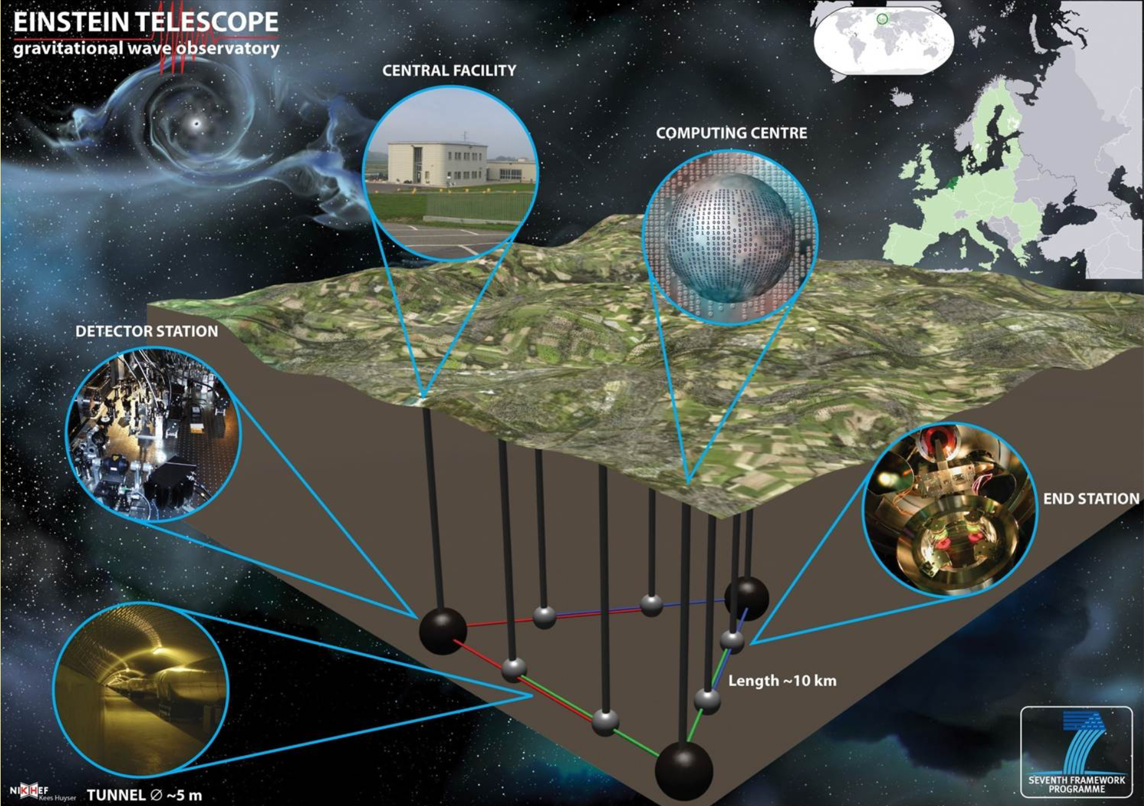
New facilities: Einstein Telescope
http://www.et-gw.eu/index.php/etdsdocument

Slide 38
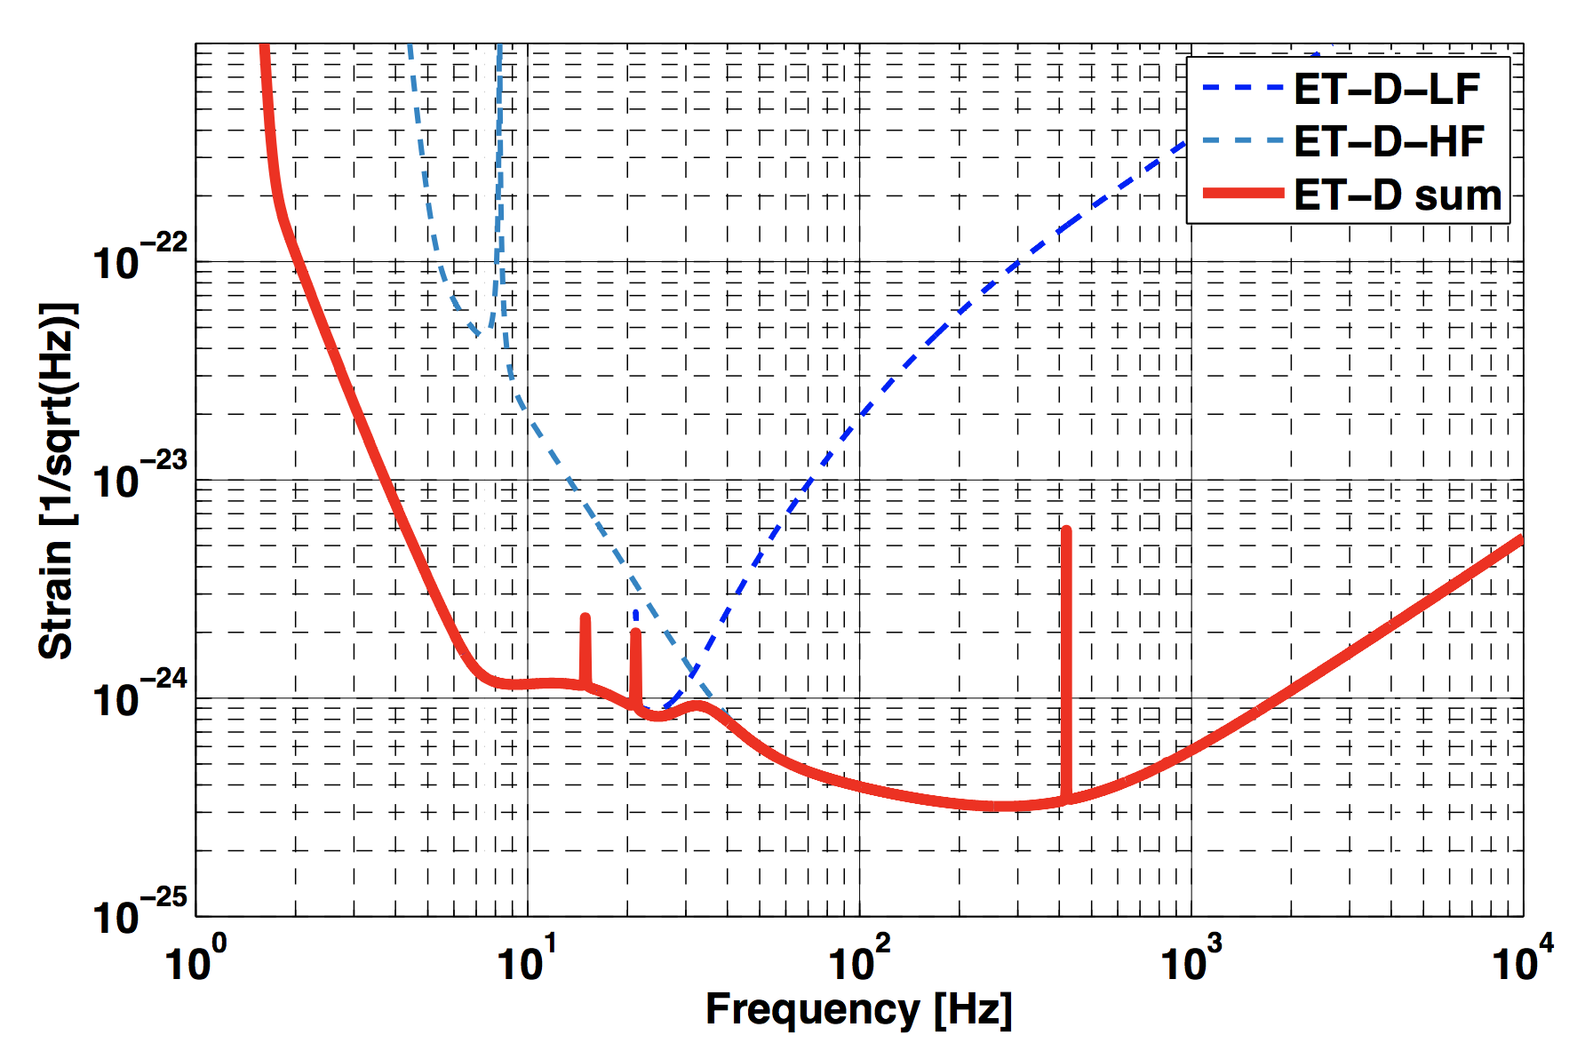
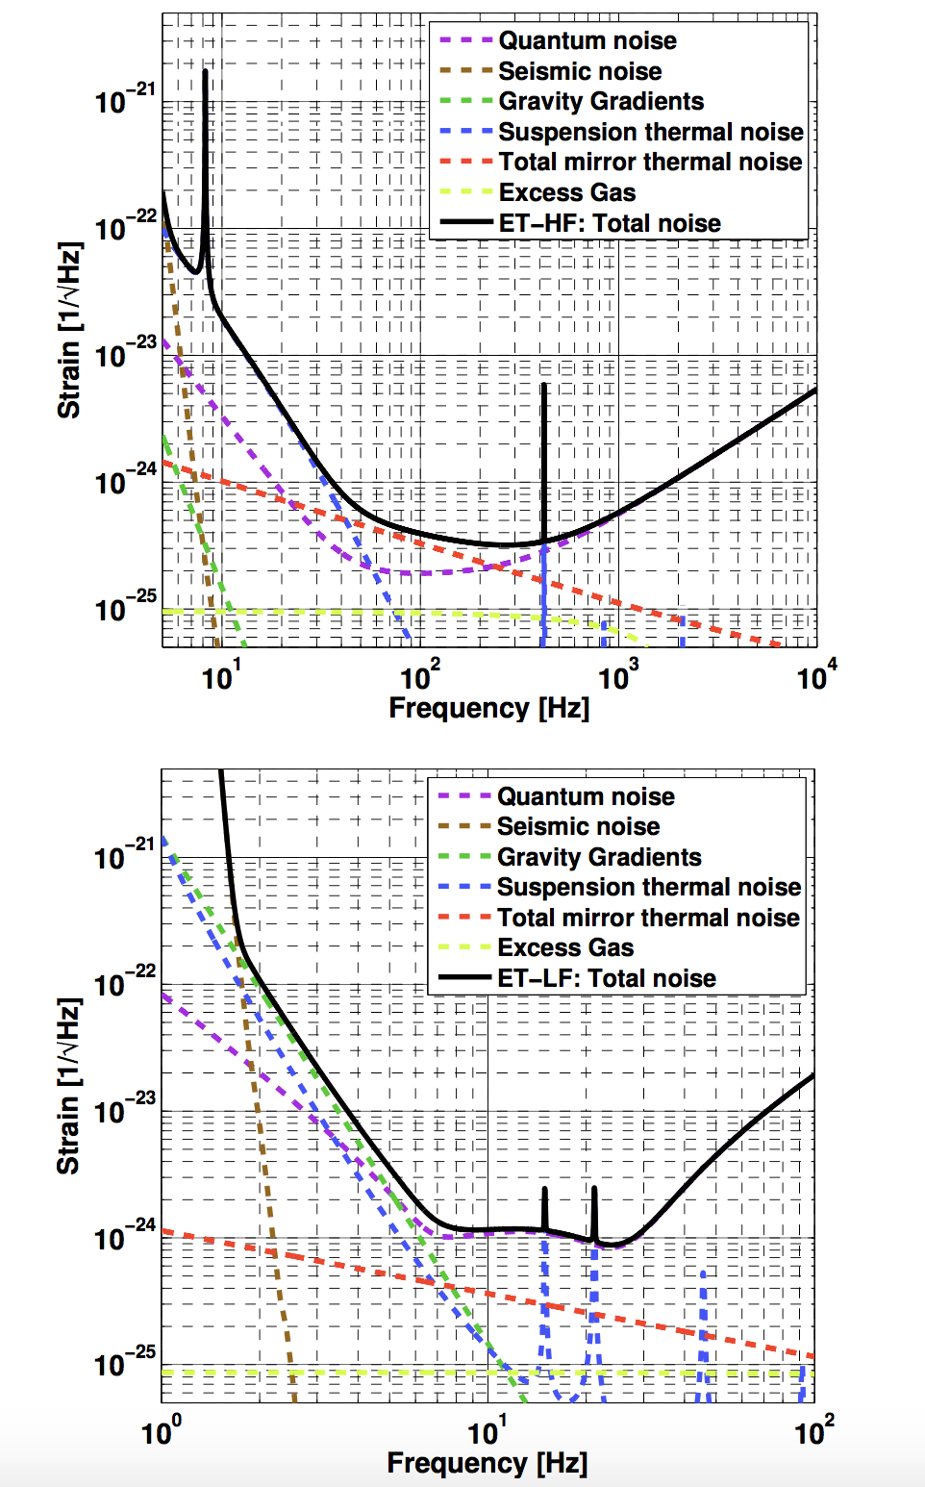
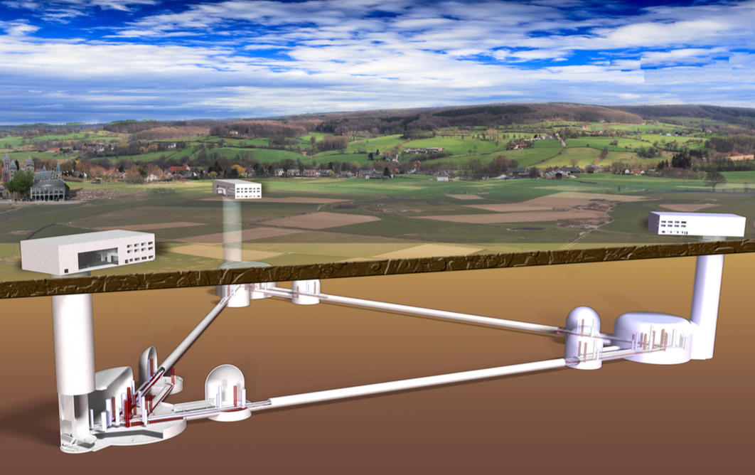
Einstein Telescope
http://www.et-gw.eu/index.php/etdsdocument

Slide 39
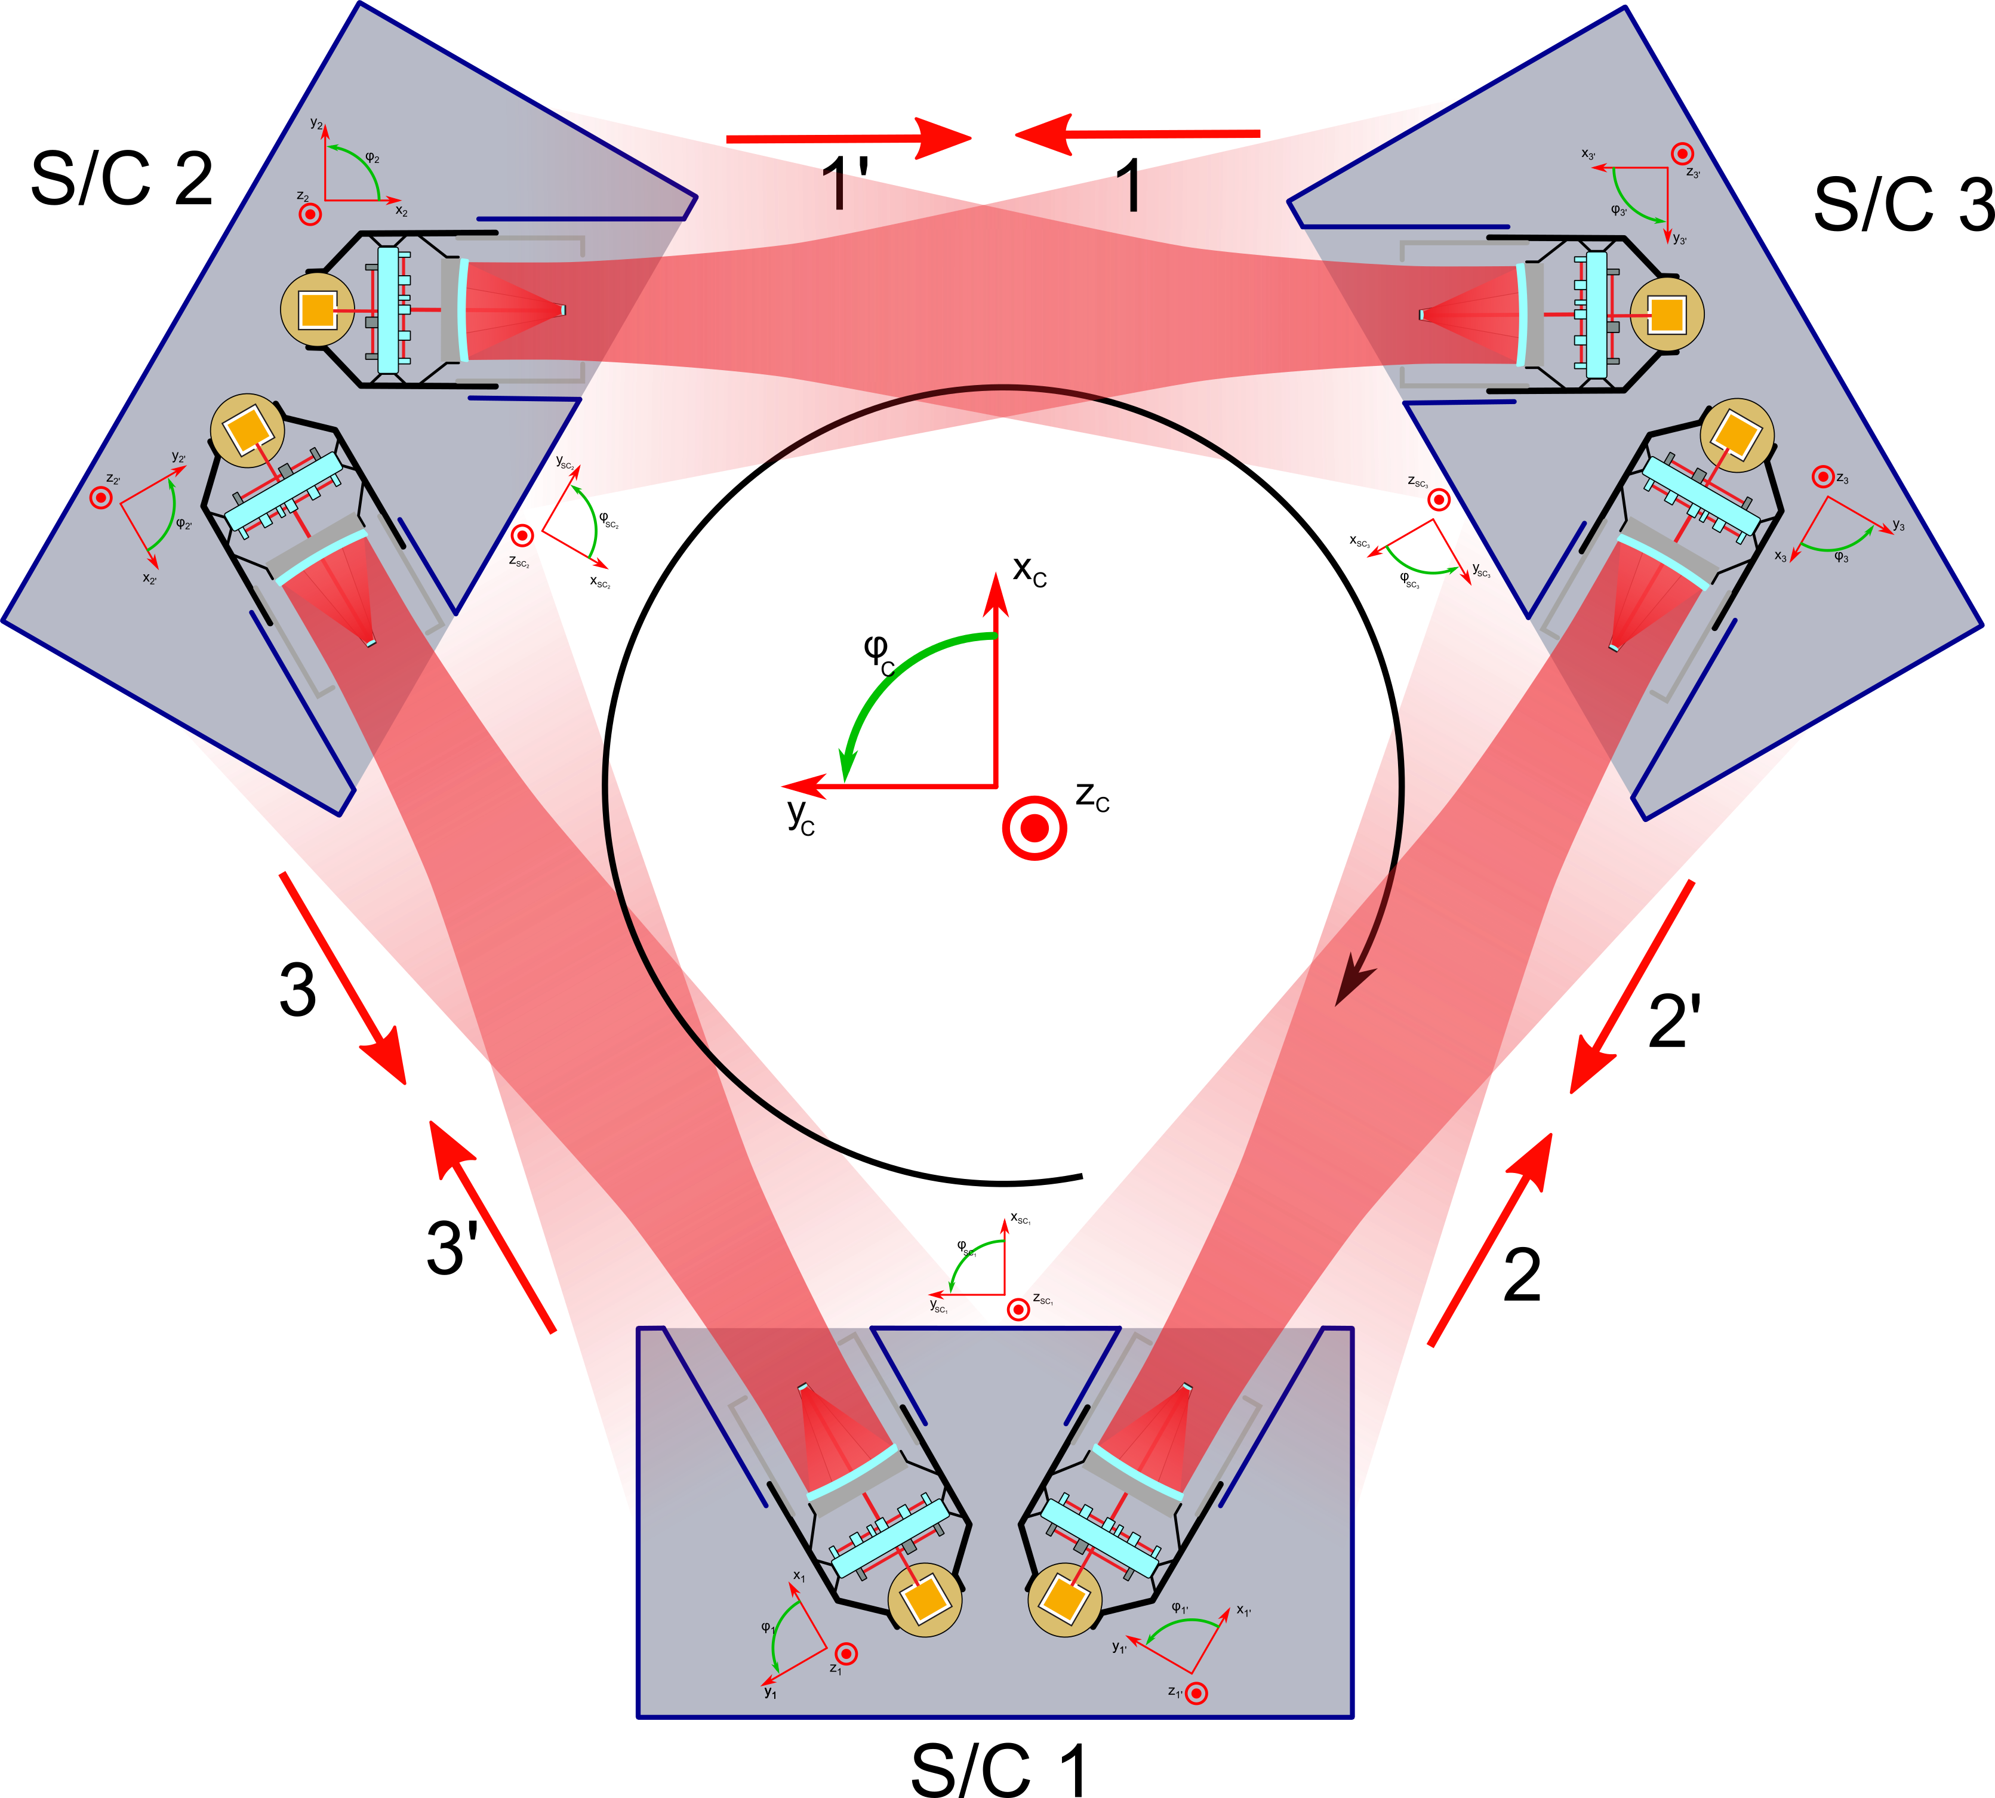
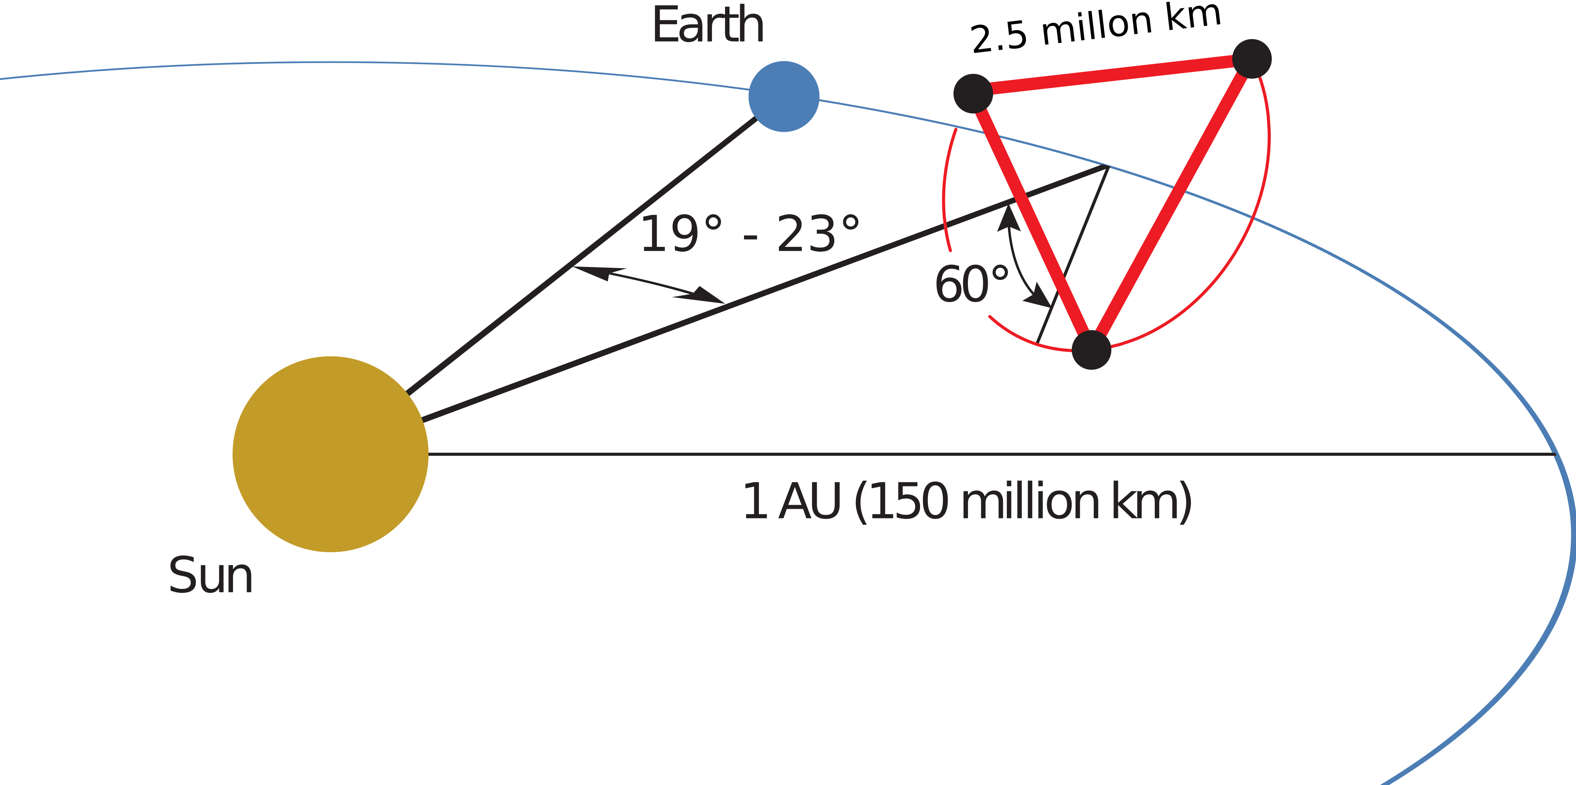
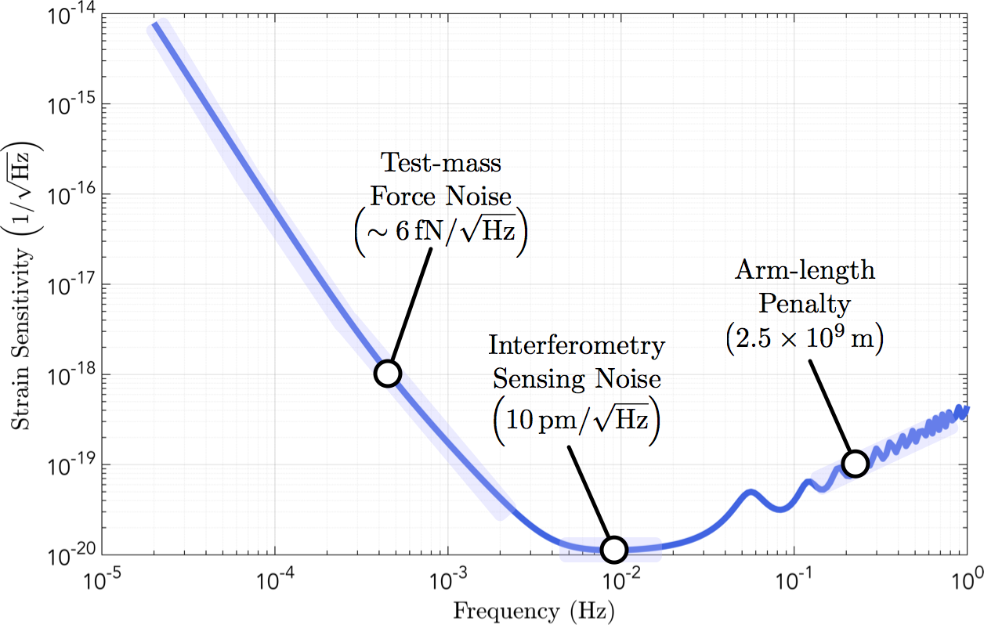
Going large and far: LISA
https://dcc.ligo.org/LIGO-G1800974/public

Slide 40
An old but still good introduction to GW detectors:
Peter R. Saulson “Fundamentals of Interferometric
Gravitational Wave Detectors”,
World Scientific (1994)
A collection of lectures on more advanced and recent topics:
Massimo Bassan, editor “Advanced Interferometers
and the Search for Gravitational Waves”,
Springer (2014)
The first discovery paper:
B. P. Abbott et al. “Observation of Gravitational
Waves from a Binary Black Hole Merger”
PRL 116, 061102 (2016)
The binary neutron star discovery paper:
B. P. Abbott et al. “GW170817: Observation of
Gravitational Waves from a Binary Neutron Star Inspiral”,
PRL 119, 161101 (2017)
A good and brief introduction to the
Advanced LIGO detectors
B. P. Abbott et al. “GW150914: The
Advanced LIGO Detectors in the Era
of First Discoveries”,
Phys. Rev. Lett. 116, 131103
Another introduction to GW detectors,
with a bit of historical perspective
Pitkin, M., Reid, S., Rowan, S. et al.
“Gravitational Wave Detection by
Interferometry (Ground and Space)”,
Living Rev. Relativ. (2011) 14: 5.
Work-in-progress notes:
https://tinyurl.com/GW-notes-2018
They cover all of lecture 1, some of lecture 2,
none of lecture 3. May contains mistakes, typos
And are updated continuously
Gabriele Vajente
LIGO Laboratory California Institute of Technology
1200 E. California Blvd.
Pasadena (CA) 91125 – USA
vajente@caltech.edu

